Slide 1
Introduction to Operating Systems
Dr Sana Belguith

Slide 2
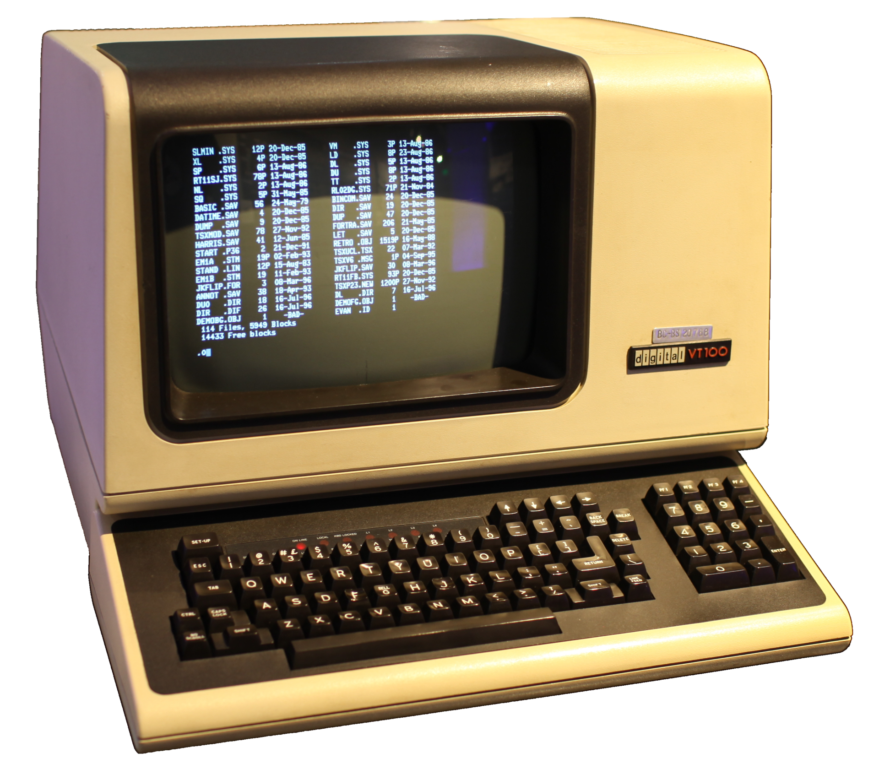

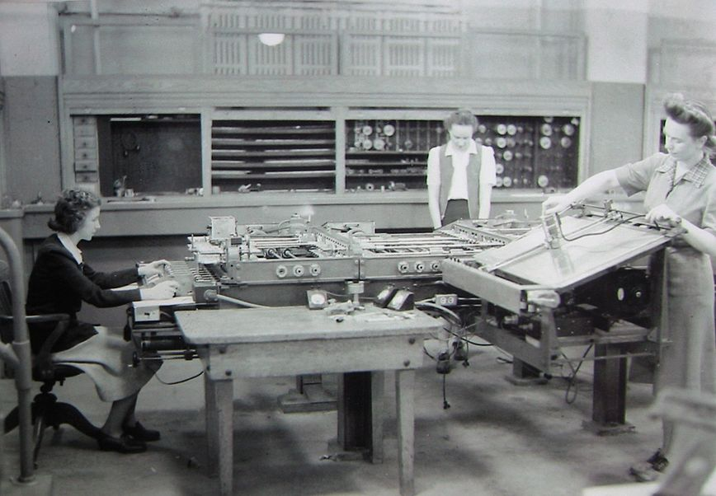
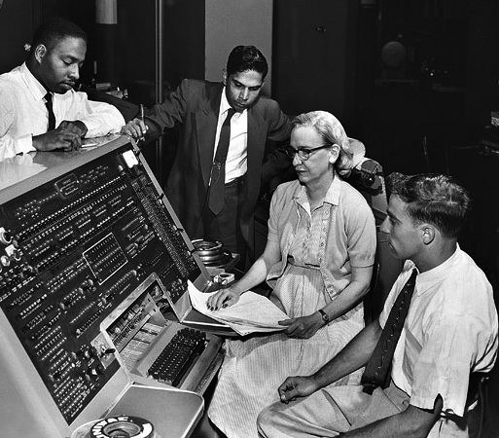
History of Operating Systems
Phase 0: no operating systems (1940-1955):
Program in machine language
Program manually loaded via card decks
Phase 1: Introducing Terminals (1955-1970)
Move the users away from the computer, give them terminal
OS is a batch monitors, a program that: Load a user job, Run it, Move to the next
First OS (1963- 1968)
Operating Systems did not really work
OS/360 introduced in 1963… worked in 1968
Systems were enormously complicated
Written in assembly code
No structured programming
(extra read) The Mythical Man-Month

Slide 3
What is an operating system?
A computer program that
Multiplexes hardware resources
Implements resource abstractions
It is just another program… but a large and complex one
most complex piece of code you would have seen so far
Multiplexing: allows multiple people or programs to use the same set of hardware resources—​processors, memory, disks, network connection—​safely and efficiently.
Abstractions: processes, threads, address spaces, files, and sockets—​simplify the usage of hardware resources by organizing information or implementing new capabilities.

Slide 4
Why study OS?
Reality: this is how computers really work, and as a computer scientist or engineer you should know how computers really work.
Ubiquity: operating systems are everywhere, and you are likely to eventually encounter them or their limitations.
Beauty: operating systems are examples of mature solutions to difficult design and engineering problems. Studying them will improve your ability to design and implement abstractions.

Slide 5
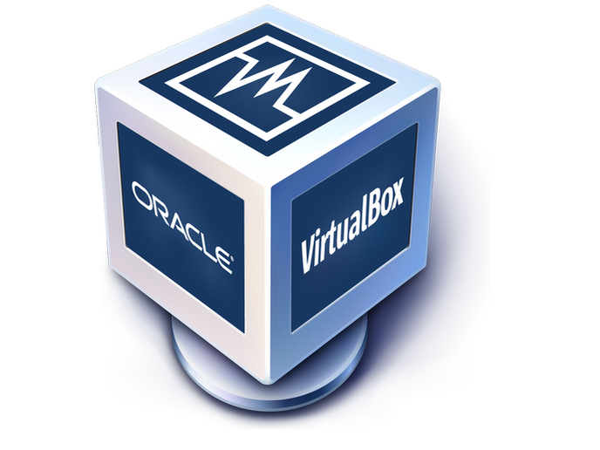


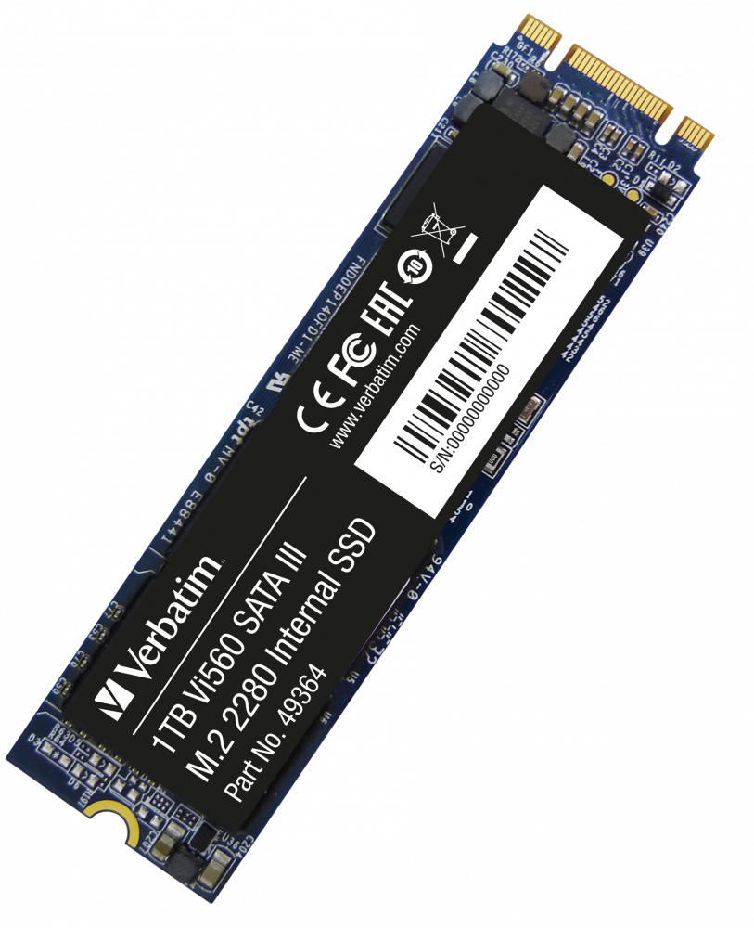
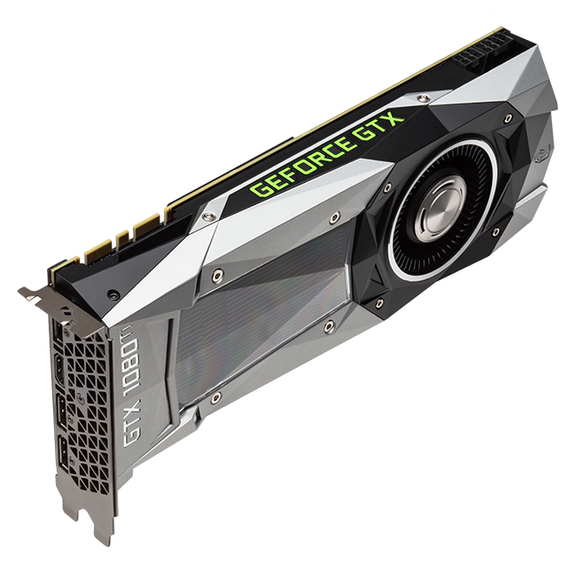
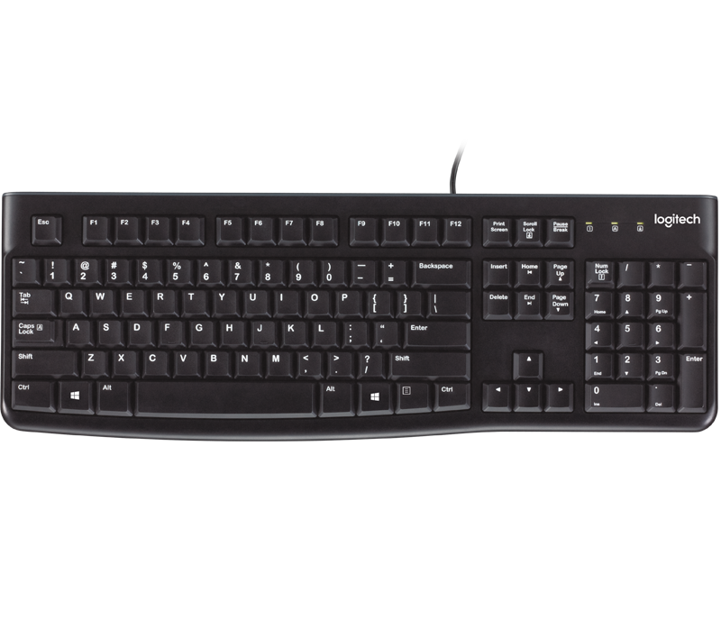

What is an OS?
Protection Boundary
Kernel
File System Networking
Device Drivers Processes
Virtual Memory
Hardware/Software Interface

Slide 6
Protection Boundaries
Multiple privilege levels
Different software can run with different privileges
Processors provide at least two different modes
User space: how “regular” program run
Kernel mode: How the kernel run
The mode determine a number of things
What instructions may be executed
How addresses are translated
What memory locations can be accessed (through translation)

Slide 7
Example Intel
Four modes
Ring 0: most privileged run the kernel here
Ring 1/2: ignored in most environment. Can run less privileged code (e.g. third party device drivers or virtual machine monitors etc.)
Ring 3: where “normal” processes live
Memory is divided in segments
Each segment has a privilege level (0 to 3)
Processor maintain a current privilege level (CPL) generally the CPL of the segment containing the instruction currently executing
Can read/write in segment when CPL >= segment privilege
Cannot directly call code in segment where CPL < segment privilege

Slide 8
Example MIPS*
Standard two modes processor
User mode: access CPU registers; flat uniform virtual memory address space
Kernel mode: can access memory mapping hardware and special registers
* Microprocessor without Interlocked Pipelined Stages

Slide 9
Changing Protection Level
How do we transfer control between applications and kernel?
When do we transfer control between applications and kernel?

Slide 10
Changing Protection Level: When?
Sleeping beauty approach
Wait for something to happens to wake up the kernel
What might that be?
System calls: an application wants the operating to do something on its behalf (e.g. access some hardware)
Trap: an application does unintentionally something it should not (e.g. divide by zero, read an address it should not etc.)
Interrupts: An asynchronous event (e.g. I/O completion)
Alarm clock approach
Set a timer that generate an interrupt when it finishes

Slide 11
System Call
A system call is a way for programs to interact with the operating system. A computer program makes a system call when it makes a request to the operating system’s kernel.
System call provides the services of the operating system to the user programs via Application Program Interface (API). It provides an interface between a process and operating system to allow user-level processes to request services of the operating system.

Slide 12
Trap
Traps are the general means for invoking the kernel from user code.
We usually think of a trap as an unintended request for kernel service, say that caused by a programming error such as using a bad address or dividing by zero.
Traps can be triggered by an exception or error in a process when executing a function. Conditions like division by zero, a breakpoint, or invalid memory access occur synchronously with the execution of a program. They can result in an exception that changes the operation of the processor. Once the cause of the exception has been handled, the processor returns to its previous activity.

Slide 13
Interrupt
An interrupt is a hardware or software signal that demand attention from the OS.
Unlike a trap, which is handled as part of the program that caused it (though within the operating system in privileged mode), an interrupt is handled independently of any user program.
For example, a trap caused by dividing by zero is considered an action of the currently running program; any response directly affects that program. But the response to an interrupt from a disk controller may or may not have an indirect effect on the currently running program and has no direct effect (other than slowing it down a bit as the processor deals with the interrupt).

Slide 14
Operating System Abstractions
Abstractions simplify applications design by:
Hiding undesirable properties;
Adding new capabilities;
Organizing information.
Abstractions provide an interface to programmers that separates policy – what the interface commits to accomplish – from the mechanism – how the interface is implemented.

Slide 15
Abstractions
Threads
Abstract the CPU
Address space
Abstract the memory
Files
Abstract the disk

Slide 16
Abstraction example: File
What undesirable properties file systems hide?
Disk are slow!
Chunk of storage are distributed all over the disk.
Disk storage may fail.
What new capabilities do files add?
Growth and shrinking.
Organization into directories.
What information files help to organize?
Ownership and permission.
Access time, modification time, type etc.

Slide 17
The process abstraction
Processes are the most fundamental abstraction
What the computer “is doing”.
Help organize other abstractions.
You know processes as “applications”.

Slide 18
The process abstraction
Processes are not tied to a hardware component.
They contain and organize other abstractions.
Thread
Thread
Thread
Address space
File handle
Mode = RW
Offset
File handle
Mode = R
Offset
/tmp/note.txt
/home/bob/conf.ini

Slide 19
Processes vs Threads
Potentially confusing due to terminology
both described as running
Some terminology useful to remember the distinction
Processes require multiple resources: CPU, memory, files
Threads abstract the CPU
A process contains threads, threads belong to a process
Except kernel threads who do not belong to a user space process
A process is running when one or more of its threads are running

Slide 20
Process Example: Firefox
Firefox has multiple threads. What do they do?
Waiting and processing interface events (e.g., mouse click)
Redrawing the screen as necessary (responding to user inputs)
Loading web pages (generally multiple elements in parallel)
Firefox is using memory. For what?
The executable code itself
Shared library: web page parsing, TLS/SSL etc.
Stacks storing local variables for running threads
Storing dynamically allocated memory
Firefox has files open. Why?
Fonts
Configuration files

